Slide 1

BANKURA UNNAYANI INSTITUTE OF ENGINEERING
Connectly: File Sharing Real Time Chat App
Submitted By:
Sumangal Dutta- 10500222015
Subhadeep Dutta- 10500222006
Arup Mandal- 10500222002
Subhankar Ghosh- 10500222023
Mustafiz Khan- 10500122006
Under Guidance Of:
Mr. Naimuddin Seikh
(Assistant Professor, Computer Science & Engineering)

Slide 2
INDEX
TOPIC | PAGES
Introduction | 3
Scope of the work | 4
Objective(s) of the work | 5
Literature Review | 6
Formulation of the identified problem | 7
Applications of the proposed work | 8
Steps to develop chat app from scratch | 9
Tools and technologies | 10-13
Key features | 14
CONCLUSION and reference | 15

Slide 3

INTRODUCTION
Welcome to Connectly: File Sharing Real Time Chat App, a web application
built using the powerful MERN stack.
MERN, which stands for MongoDB,
React, and Node.js, is a
robust and scalable technology stack
that enables the development of fast,
secure, and efficient web
applications.

Slide 4
LITERATURE REVIEW
[1] Zala, Nidhi, Jinan Fiaidhi, and Vinita Agrawal - LIETRETURE REVIEW FROM GOOGLE SCOLAR , SCI HUB
Focuses on the design of a real-time collaboration and chat application, emphasizing features like group chat, encryption for secure communication, and cross-platform functionality.
Key technologies include React.js, Node.js, Express.js, and MongoDB, which enhance performance and usability compared to PHP-based systems.
[2] Vinoth Kumar, G., and G. Dhivya - LIETRETURE REVIEW FROM GOOGLE SCOLAR , SCI HUB
Discusses the development of web-based systems using the MERN stack to address communication, e-commerce, and institutional management needs.
Features include a College ERP system for efficient academic data management, an e-commerce platform for seamless transactions, and a secure chat application with private and public communication capabilities.
Drawbacks-- large data sending is difficult and inefficient;
no advertisement section for monetization

Slide 5
Scope of the Work
Design and develop a real-time chat app.
Enable users to send and receive messages instantly.
Implement features such as group chat, file sharing, and video calling.
Ensure security and privacy of user data.

Slide 6
OBJECTIVE(S) OF THE WORK
Provide a seamless and intuitive user experience.
Enable real-time communication and collaboration.
Ensure security and privacy of user data.
Achieve high performance and scalability.

Slide 7
FORMULATION OF THE IDENTIFIED PROBLEM
Users experience delays and lags in message delivery.
Security and privacy concerns are prevalent.
Limited features and functionalities.

Slide 8
APPLICATIONS OF THE PROPOSED WORK
Real-time chat app with instant message delivery.
Group chat, file sharing, and video calling features.
End-to-end encryption for secure communication.
Scalable and high-performance architecture.

Slide 9
STEPS TO DEVELOP CHAT APP FROM SCRATCH
Identify The Problem
Establish Objectives and Use Cases
Choose the Right Technology Stack
Design the User Interface (UI)
User Authentication and Security
Build the Backend Engine
Integrate Multimedia Features
Test, Launch and Iterate

Slide 10
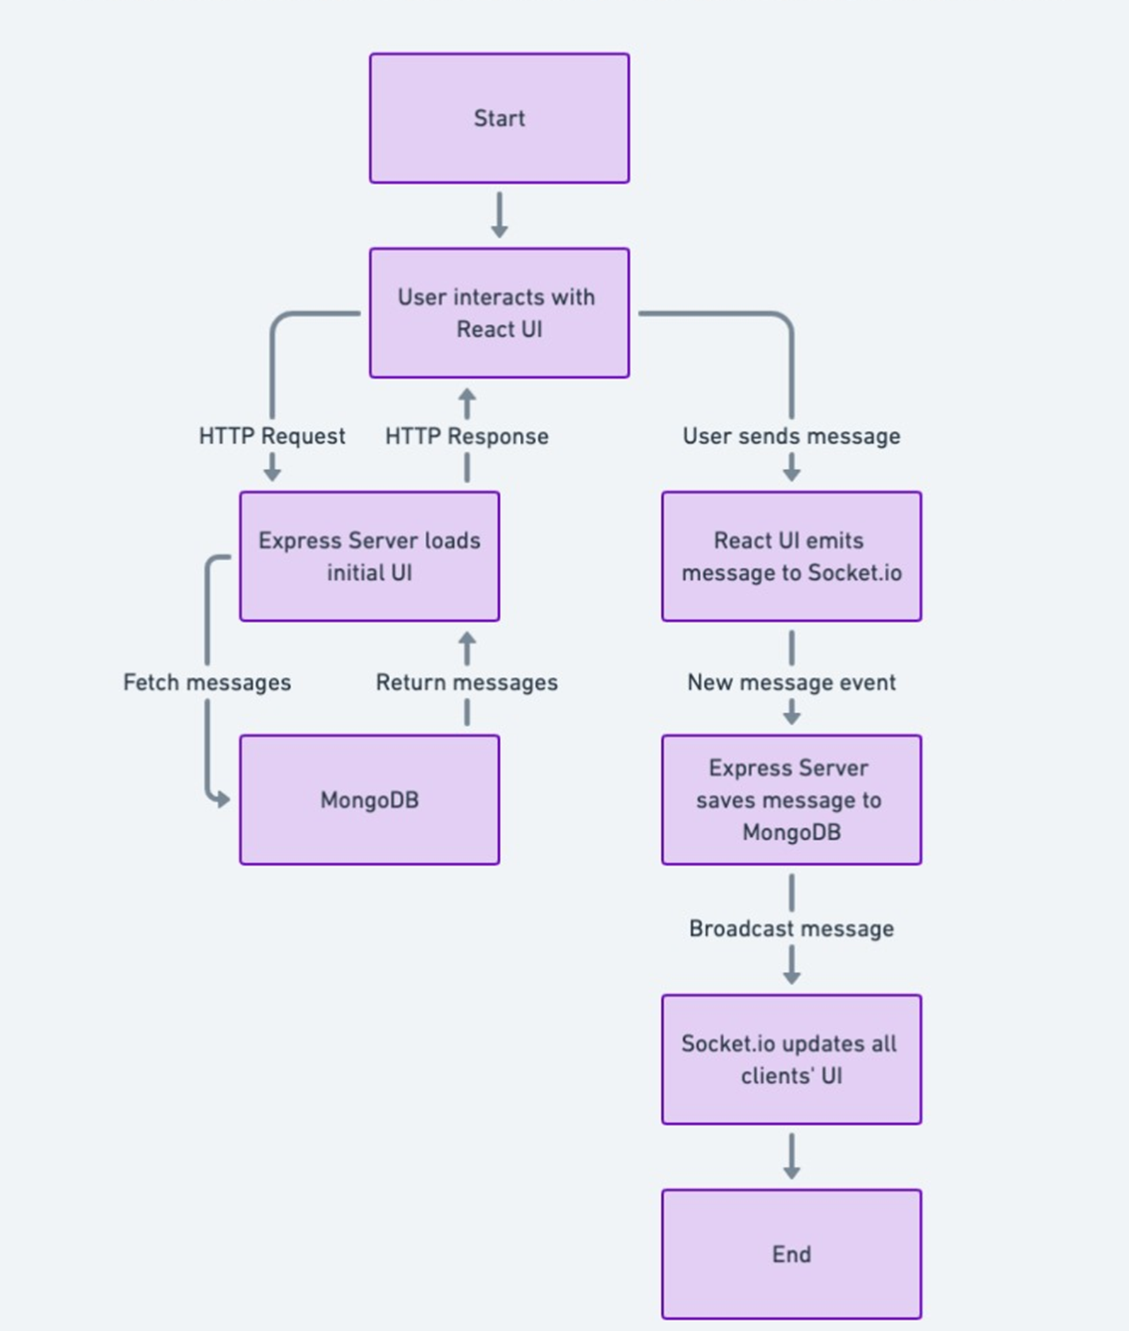
Tools and Technologies
Frontend: HTML,CSS, JavaScript, React.js, WebSocket’s
Backend: Node.js, Express.js, Socket.io
Database: MongoDB

Slide 11
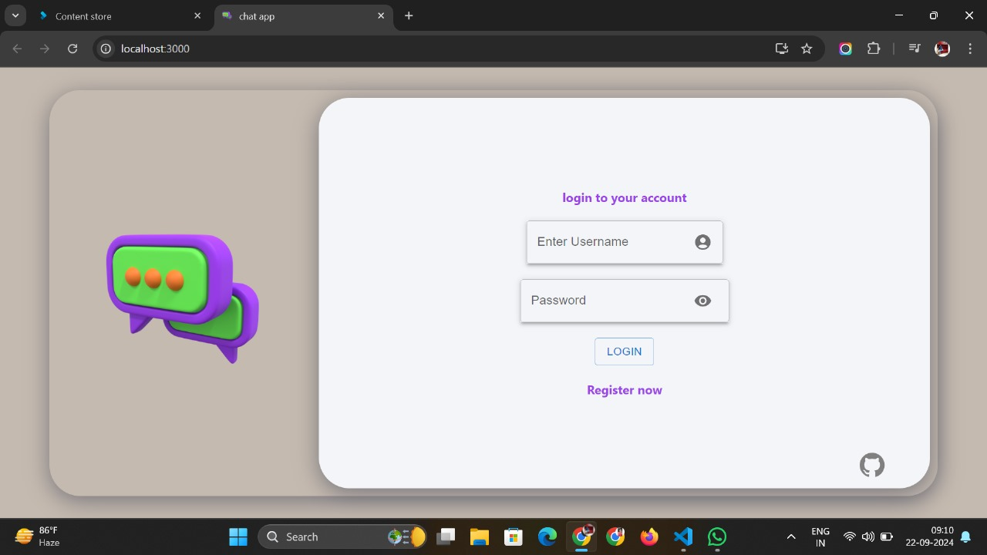
LOGIN UI

Slide 12
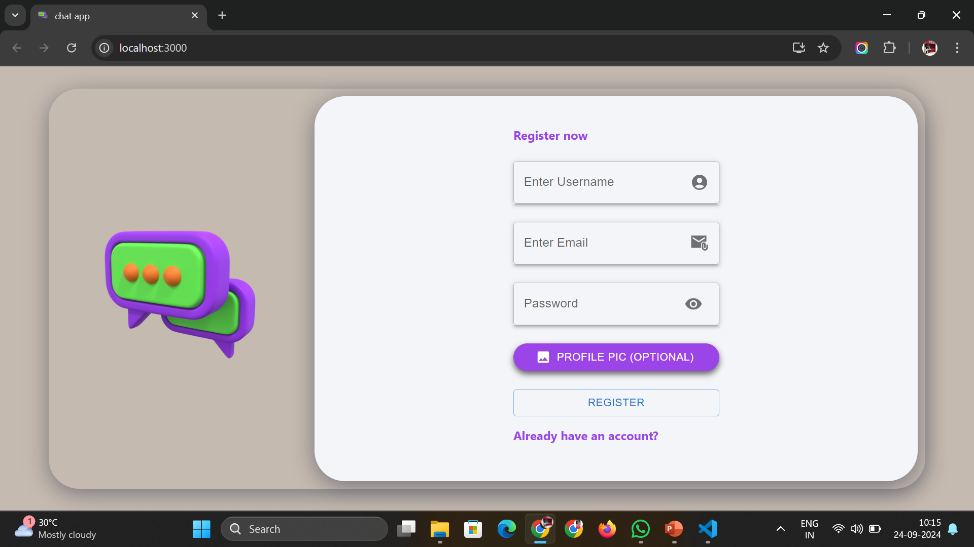
REGISTER UI

Slide 13
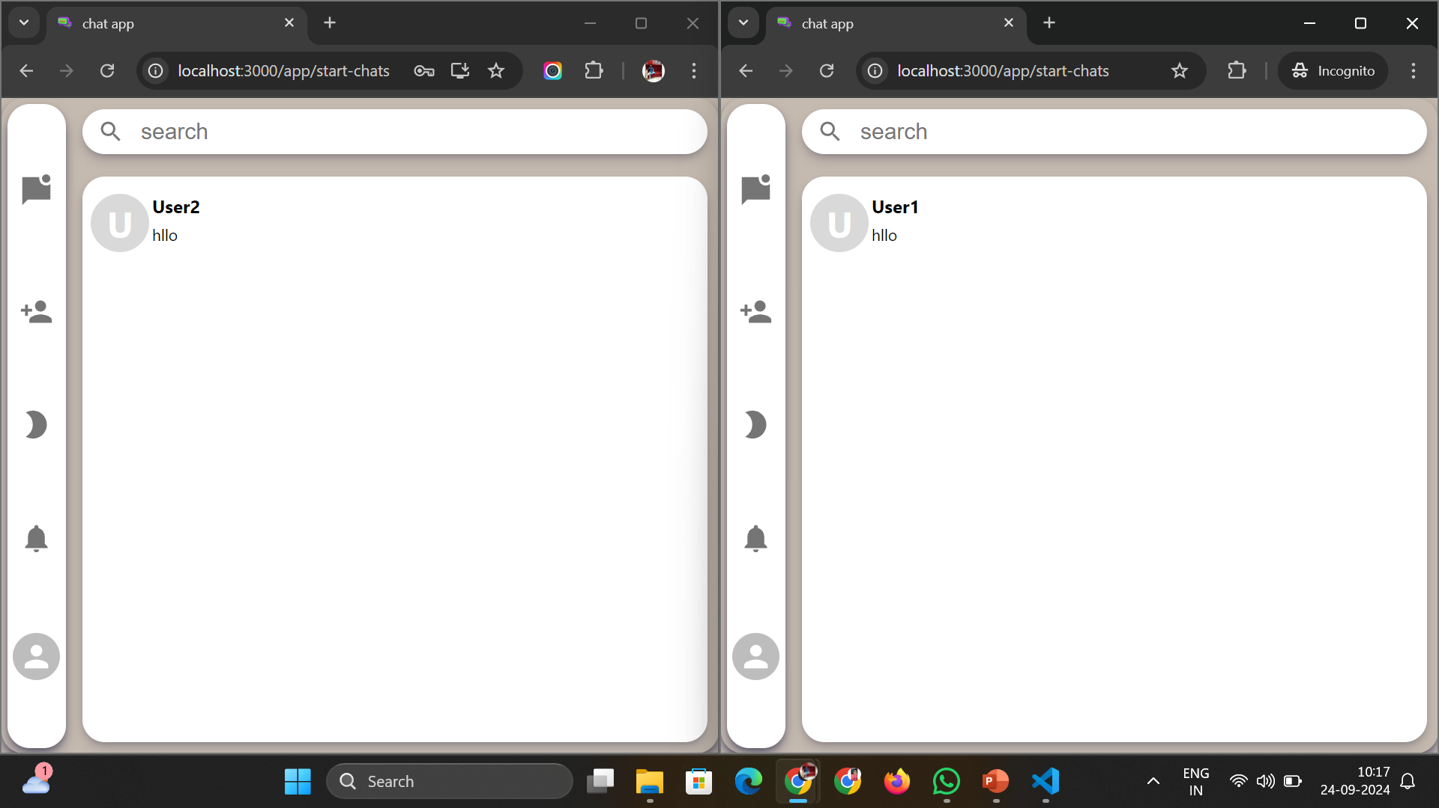
CHAT UI
DEMO LINK

Slide 14
KEY FEATURES
Real-time Messaging
User Authentication
Chat Rooms
File Sharing
Message Storage
Notifications
Responsive Design

Slide 15
CONCLUSION
The Real-time MERN Stack Chat App Project Successfully Demonstrates The Integration Of MongoDB, Express, React, And Node.js To Build A Dynamic, Real-time Communication Platform. By Utilizing Technologies Such As WebSocket's (Via Socket.IO) For Live Messaging.
REFERENCE
Internet Browser
YouTube
GitHub

Slide 16


